Slide 1

Video Game Sales Prediction Analysis
Gabriel Valenzuela

Slide 2
Background of Analysis
Video games have become a million-dollar business
New consoles being released later this year
Determine what video game genre is producing the most revenue
Per geographical location
For upcoming releases
Historical video game sales to predict future sales
New video game consoles being released every 7-8 years

Slide 3
Outline of Analysis
Data Preparation of Historical Video Game Sales Data
Sales of each game from 1980-2017
Exploratory Data Analysis
Examine existing trends whenever a new console is released
Determine which genres have highest revenue overall
Per geographical location
Model Evaluation and Selection
Chosen to use a Long-Term Short Memory Model to predict future sales

Slide 4
Outline of Analysis
Visualize
Visualize Results
Utilize R and Python
Summarize
Summarize Results and Revise Results
Present
Present Final Results

Slide 5
Progress of Analysis
Performed EDA
Top 10 Genres by Mean Global Sales
Total Game Count by Genre
Top 10 Platforms by Number of Games
Fit Regression Model
Extract Adjusted R-Squared
0.98600978

Slide 6
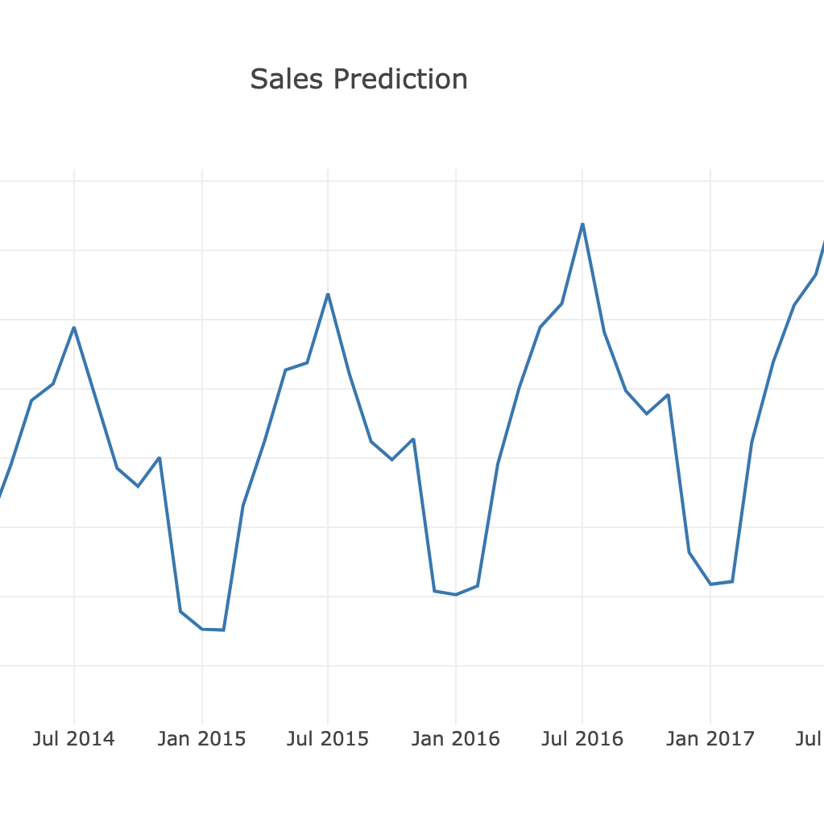
Progress of Analysis
Reshape training and testing data set
Fit LSTM Model
Reshape predicted sales for comparison
Currently Visualizing Results
Possible Visualization Example -->

Slide 7



Challenges
Determining the Adjusted R-Sqaure from the Regression Formula
Developing and fitting the data unto LTSM Model
Testing the model
Past years
Future years
Reshaping data set for predicted sales

Slide 8

Future Plans
Continue visualizing predicted sales results
Determine method to show prediction over the course of next years
Revise LTSM Model
Ensure model is predicting to its best ability
Develop Final Paper and Presentation
Summarized results of analysis and process

Slide 9
Questions?

